Slide 1
Internship Evaluation Presentation
First evaluation
Name: Aditya Patil PRN: 20210802292

Slide 2
Company
Company name: Probitech Solutions
About the company: Product and Service
Position: Data Analyst Intern
Department: Data Science
Internship Period: 7th June – 7th August

Slide 3
Responsibilities
Assist in data collection and analysis.
Prepare reports and presentations based on data findings.
Collaborate with team members on various projects.

Slide 4
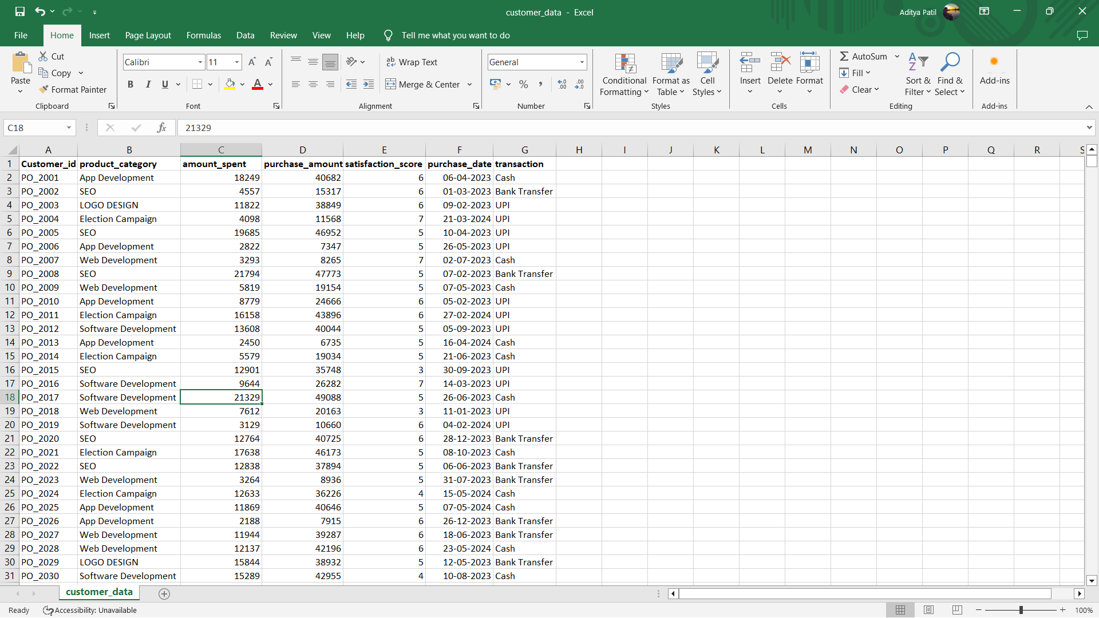
Data Collection

Slide 5
Methodology & Tool
Tools Used:
Data Collection and Cleaning: Python (Pandas, NumPy)
Analysis: python (Matplotlib, Seaborn), Excel
Visualization: Power Bi, Tableau

Slide 6
Methodology & Tool
Methodology Used:
Data Cleaning: Removing duplicates, and handling missing values.
Data Exploration: Descriptive statistics, identifying patterns.
Data Visualization: Creating charts and graphs to illustrate findings
Analysis: Identifying key trends and patterns in customer behavior

Slide 7
Key Findings
Customer & Product Segmentation:
Highest Satisfaction Score(9): Web Development
Average Satisfaction Score(5): App Development & Software Development
Poor Satisfaction Score(2): SEO & Logo Design

Slide 8
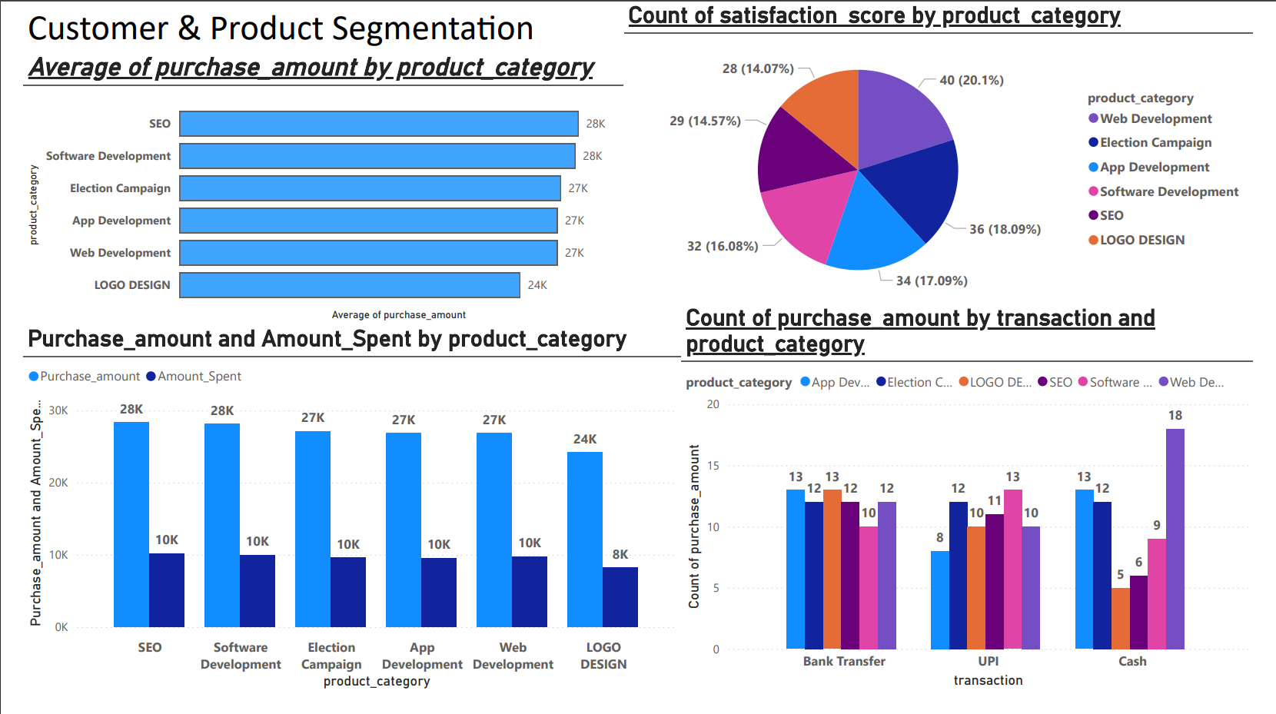
Visualizations

Slide 9
Conclusion
The dataset was about products, sales, and satisfaction.
We can conclude that web Development has the highest customer satisfaction rating
SEO and Software Development has the highest amount of spent and earned

Slide 10
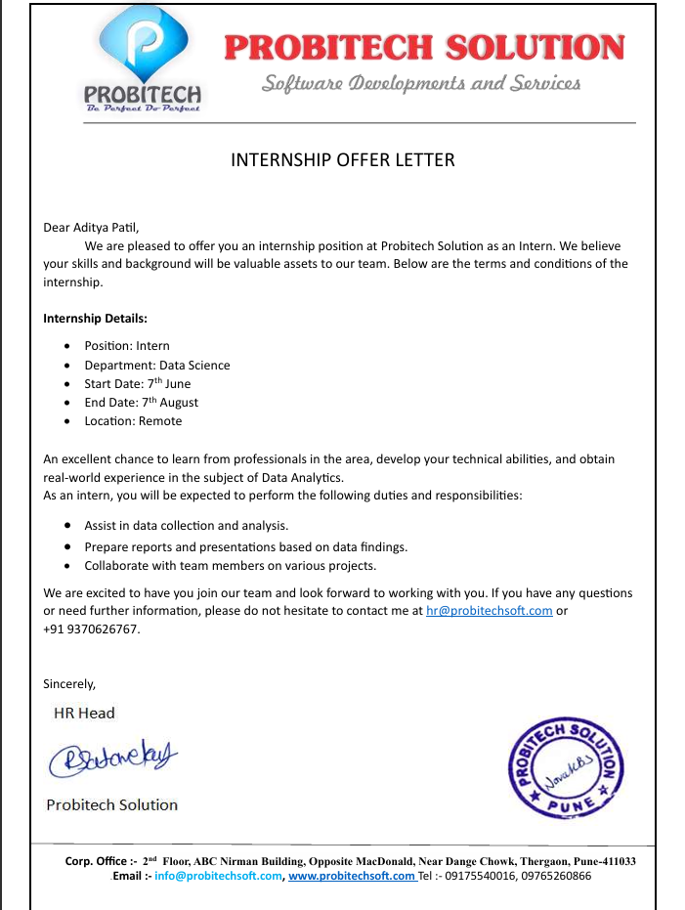
Offer Letter

Slide 11
Thank You

